Slide 1
Lab 5 SoC design and optimization
CE 435
Embedded Systems
Dimitris Christodoulou 2113
Theologis anthimopoulos 2195

Slide 2
SOBEL FILTER
CONTENT
SOBEL in Software Optimization
SOBEL in Hardware Optimization

Slide 3
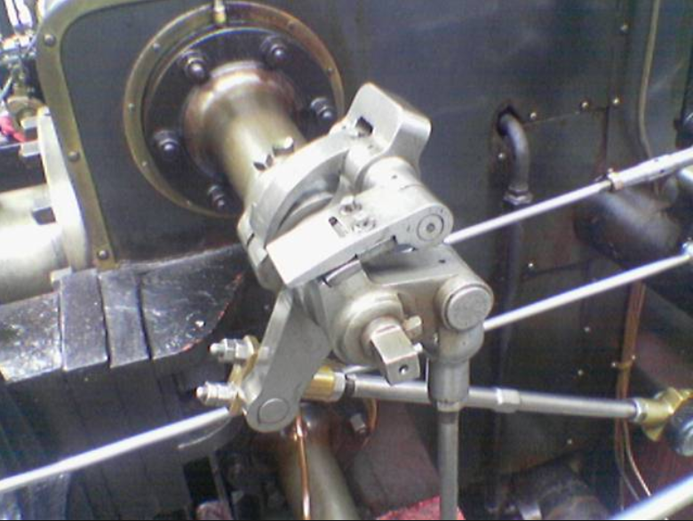
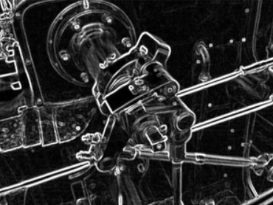
SOBEL FILTER
-1 | 0 | 1
-2 | 0 | 2
-1 | 0 | 1
1 | 2 | 1
0 | 0 | 0
-1 | -2 | -1
Gx
Gy
BEFORE
AFTER

Slide 4
SOFTWARE results
SOLUTION | TIME | PSNR
SOLUTION 1 | 1.704671 | inf
SOLUTION 2 | 0.087745 | inf
SOLUTION 3 | 0.066042 | inf
SOLUTION 4 | 0.045589 | 28.6625

Slide 5
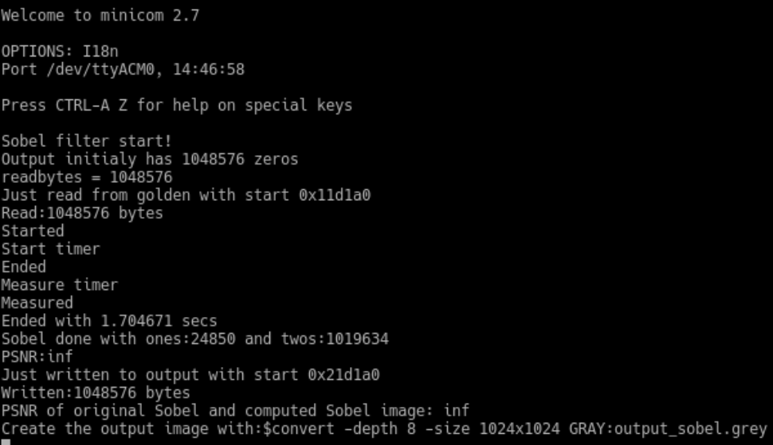
SOLUTION 1
Run Sobel Filter Code without any optimizations.

Slide 6
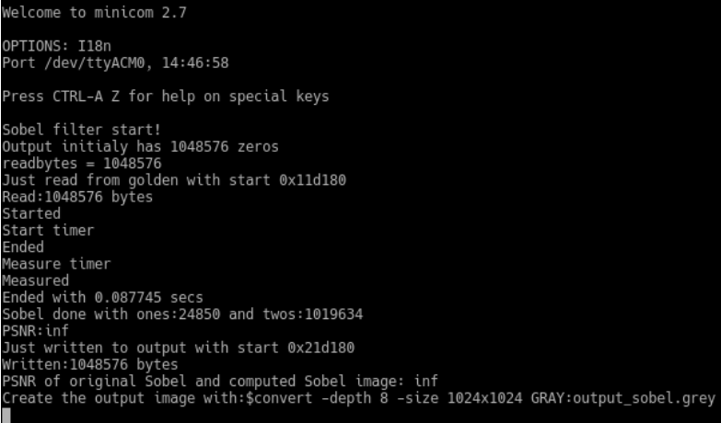
SOLUTION 2
Decreased running time using optimization level: Optimize most (-O3).

Slide 7

SOLUTION 3
Changed the order of double for loop so as to calculate pixels row-by-row instead of column-by-column.

Slide 8
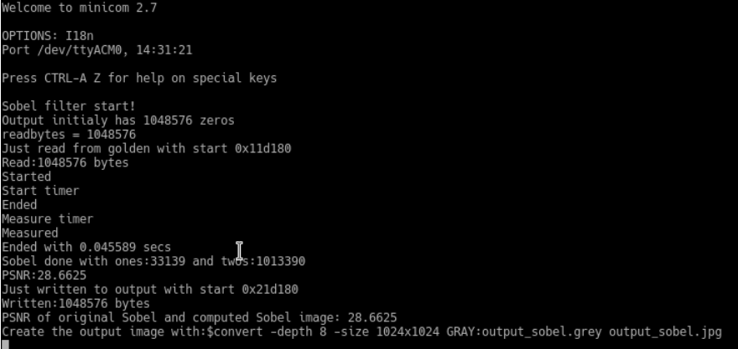
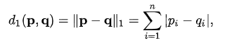
SOLUTION 4
Finally, replaced Euclidean distance with Manhattan distance in order to decrease the run time.

Slide 9
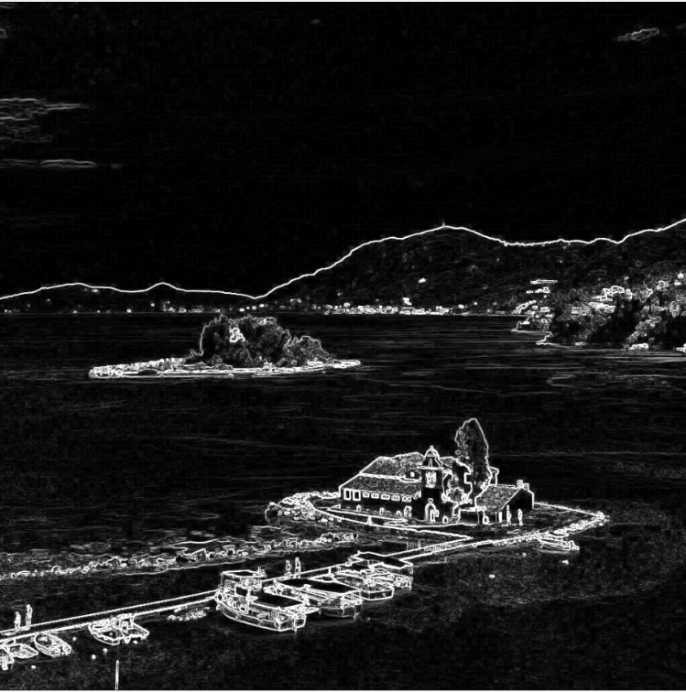

Inf PSNR VS 28.6624 PSNR

Slide 11
HARDWARE OPTIMIZATION
SOLUTIONS | TIME | PSNR
SOLUTION 1 | 2,095958 | inf
SOLUTION 2 | 1,276471 | inf
SOLUTION 3 | 0,980560 | 28.6625
SOLUTION 4 | 0,508779 | 28.6625
SOLUTION 5 | 0,027544 | 28.6625
SOLUTION 6 | 0,023087 | 28.6625
SOLUTION 7 | 0,012605 | 28.6625

Slide 12
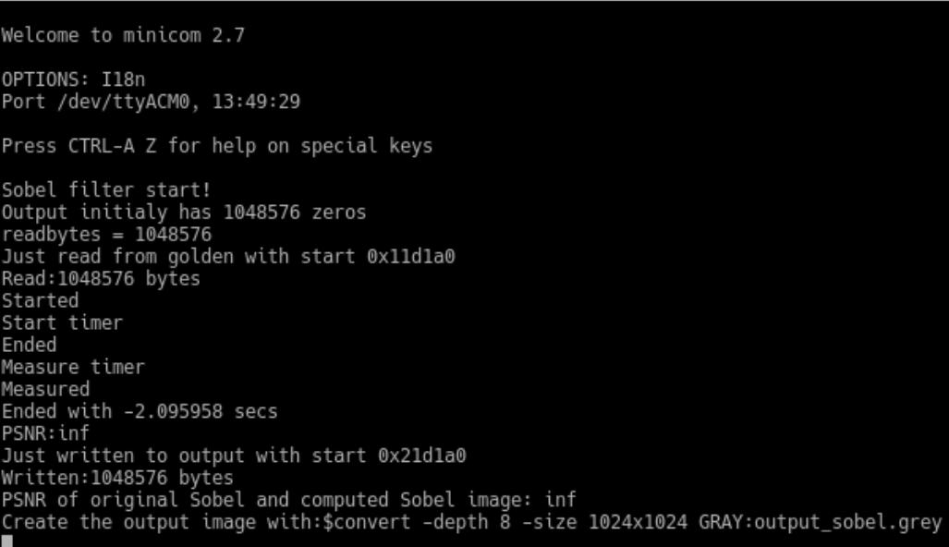
Solution 1
Run Sobel Filter Code without any optimizations.
Used m_axi for input and output.
Another pragma will be added with this with the port name “return”.

Slide 13
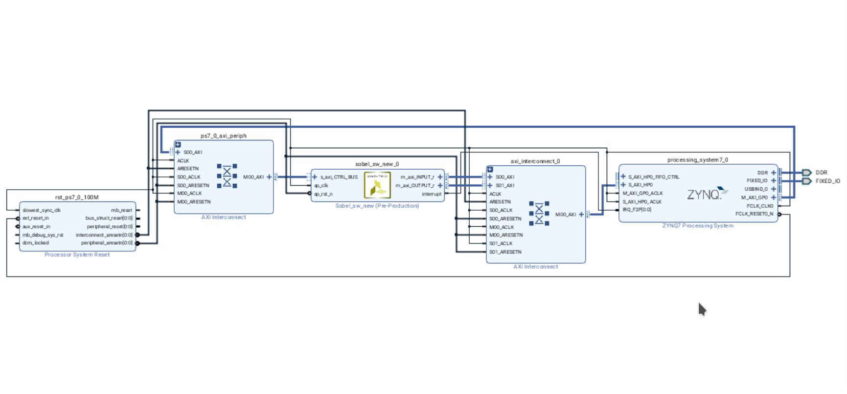
Solution 1

Slide 14
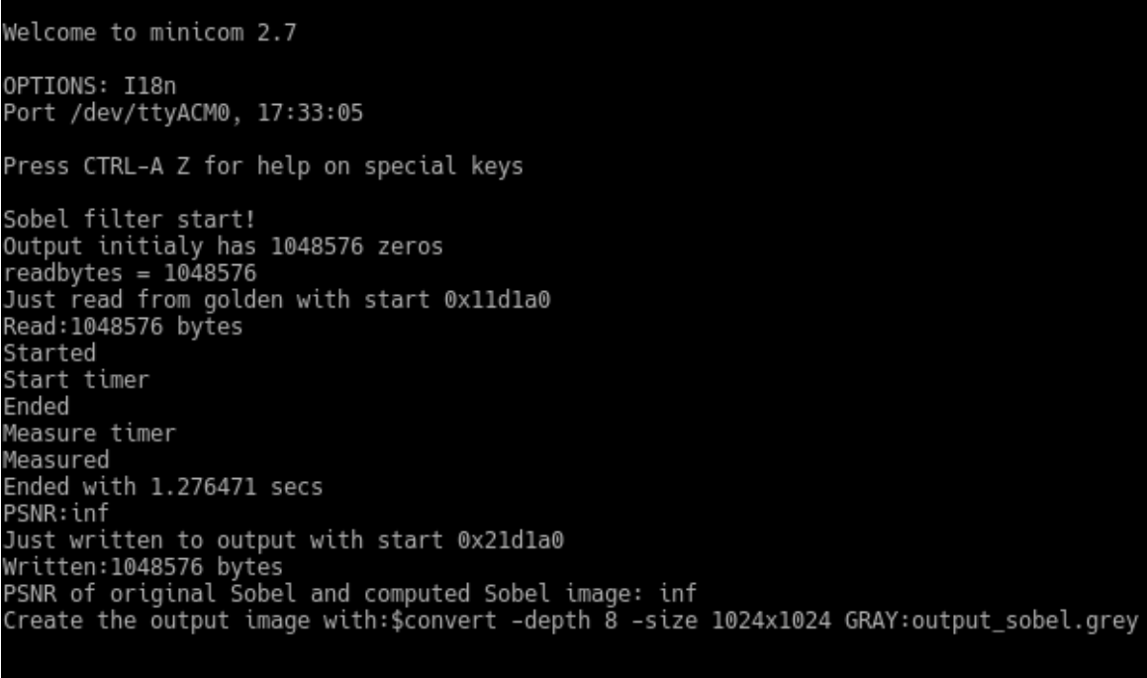
Solution 2
Added another directive to convolution2D external for-loop. (Pipeline II = 1)
Replaced multiplications with shift registers.
Changed the order of double for loop so as to calculate the row-by-row pixels

Slide 15
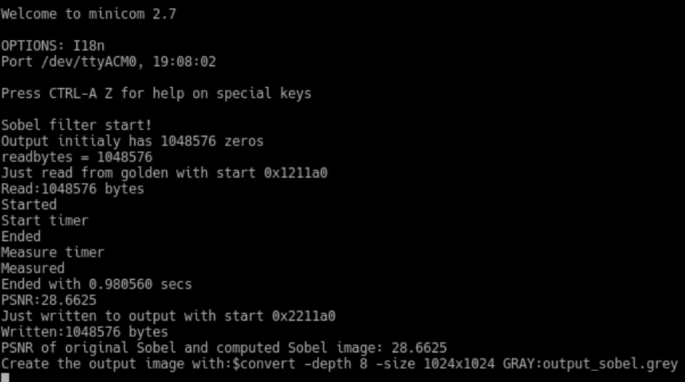
Solution 3
After that, replaced Euclidean distance with Manhattan distance so as to decrease the running time.
Removed convolution2D for-loop.

Slide 16
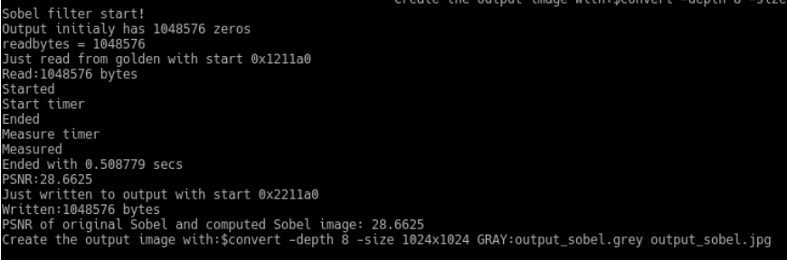
Solution 4
Added two sobel filters to Block Design.
Divided the picture and sent each half to each sobel filter.

Slide 17
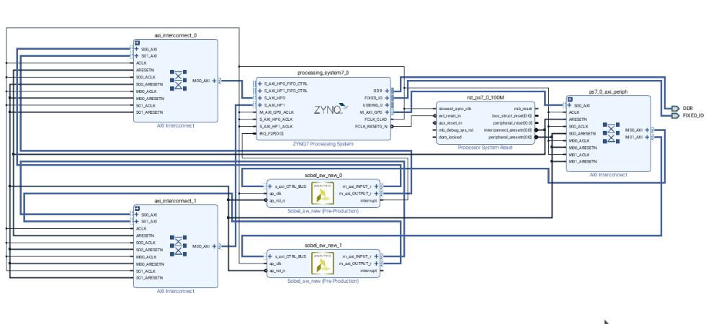
Solution 4

Slide 18
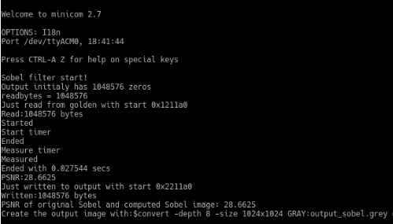
Solution 5
Added another directive to sobel internal for-loop (Pipeline). Used memcpy to load 3 rows at first and another one for each row.
Added four sobel filter to Block Design. Calculate four segment simultaneously.

Slide 19
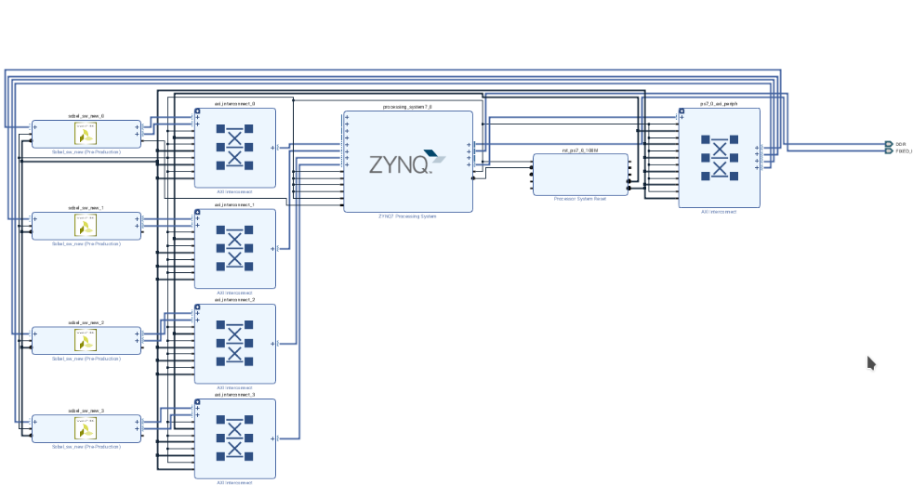
Solution 5

Slide 20
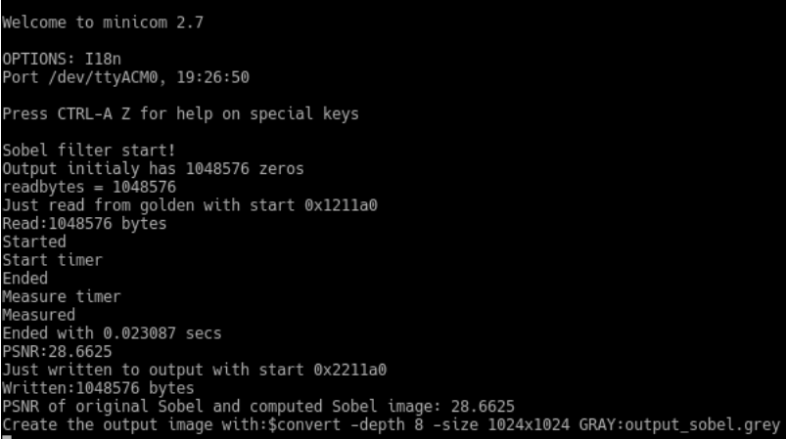
Solution 6
Changed the clock period to vivado hls. Decreased clock from 10ns to 8ns. Also, increased frequency from 100 MHz to 125Mhz.

Slide 21
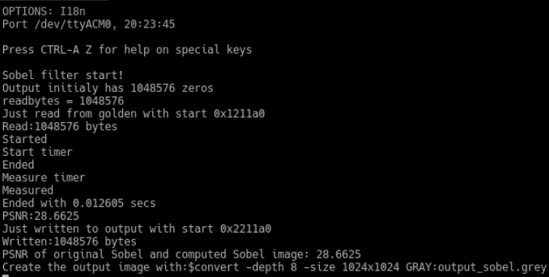
Solution 7
Changed the requested frequency. Increased frequency from 125MHz to 250MHz.

Slide 22
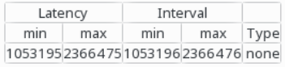
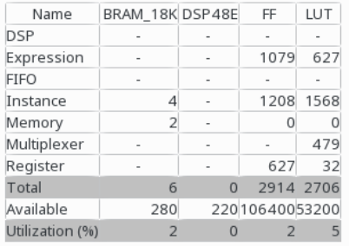
Latency
(clock cycles)
Utilization Estimates

Slide 24
SUMMARY
SOFTWARE
HARDWARE
FIRST TIME : 1,704671
LAST TIME : 0,045589
FIRST TIME : 2,095958
LAST TIME : 0,012605
97.33%
99.4%
165,9
208,4

Slide 25
SOFTWARE VS HARDWARE
BEST SOFTWARE TIME : 0,045589
BEST HARDWARE TIME : 0,012605
72.4%
3,5

Slide 26
Thank you for your attention!
Questions and comments are welcome!

